Slide 1
PFE Project: flower development
By Natalia Wołowiec
Kacper Kalinowski
Mateusz Miller

Slide 2
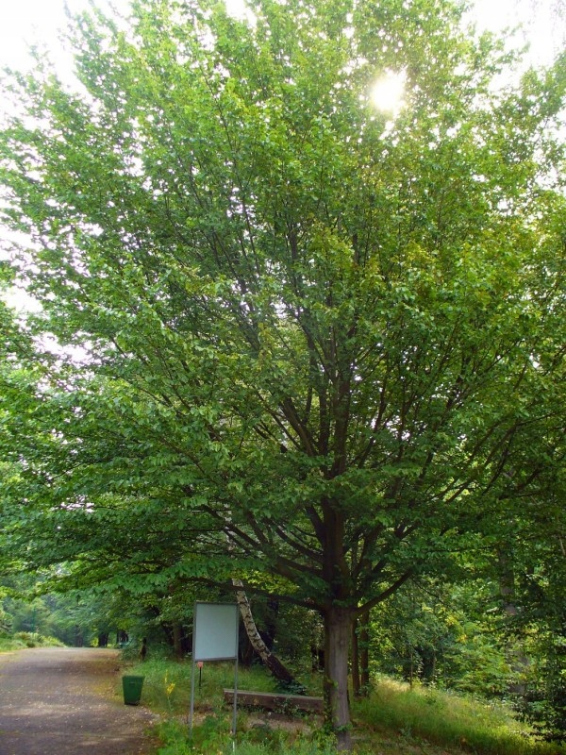
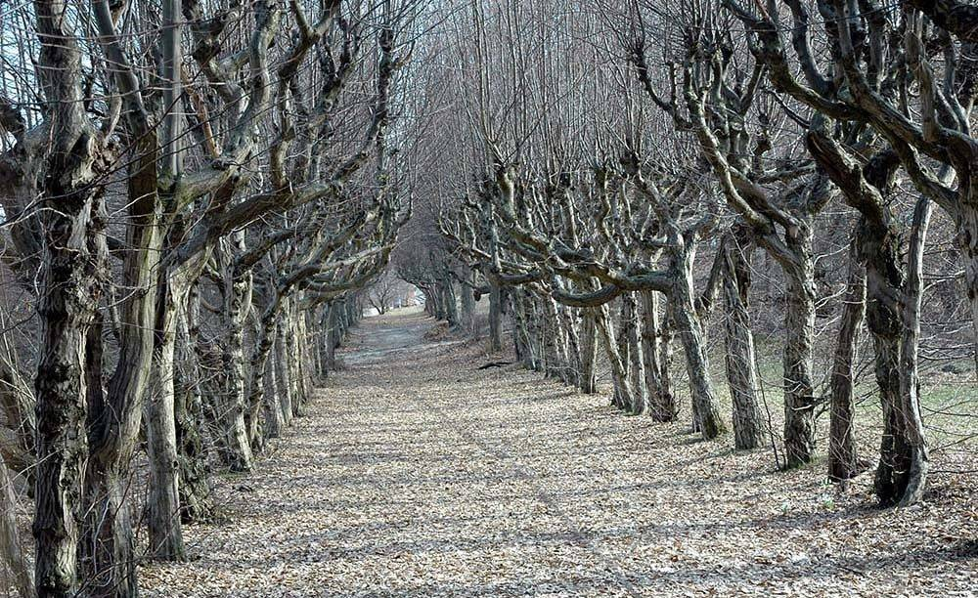
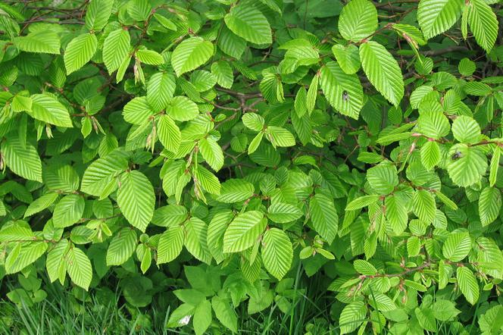
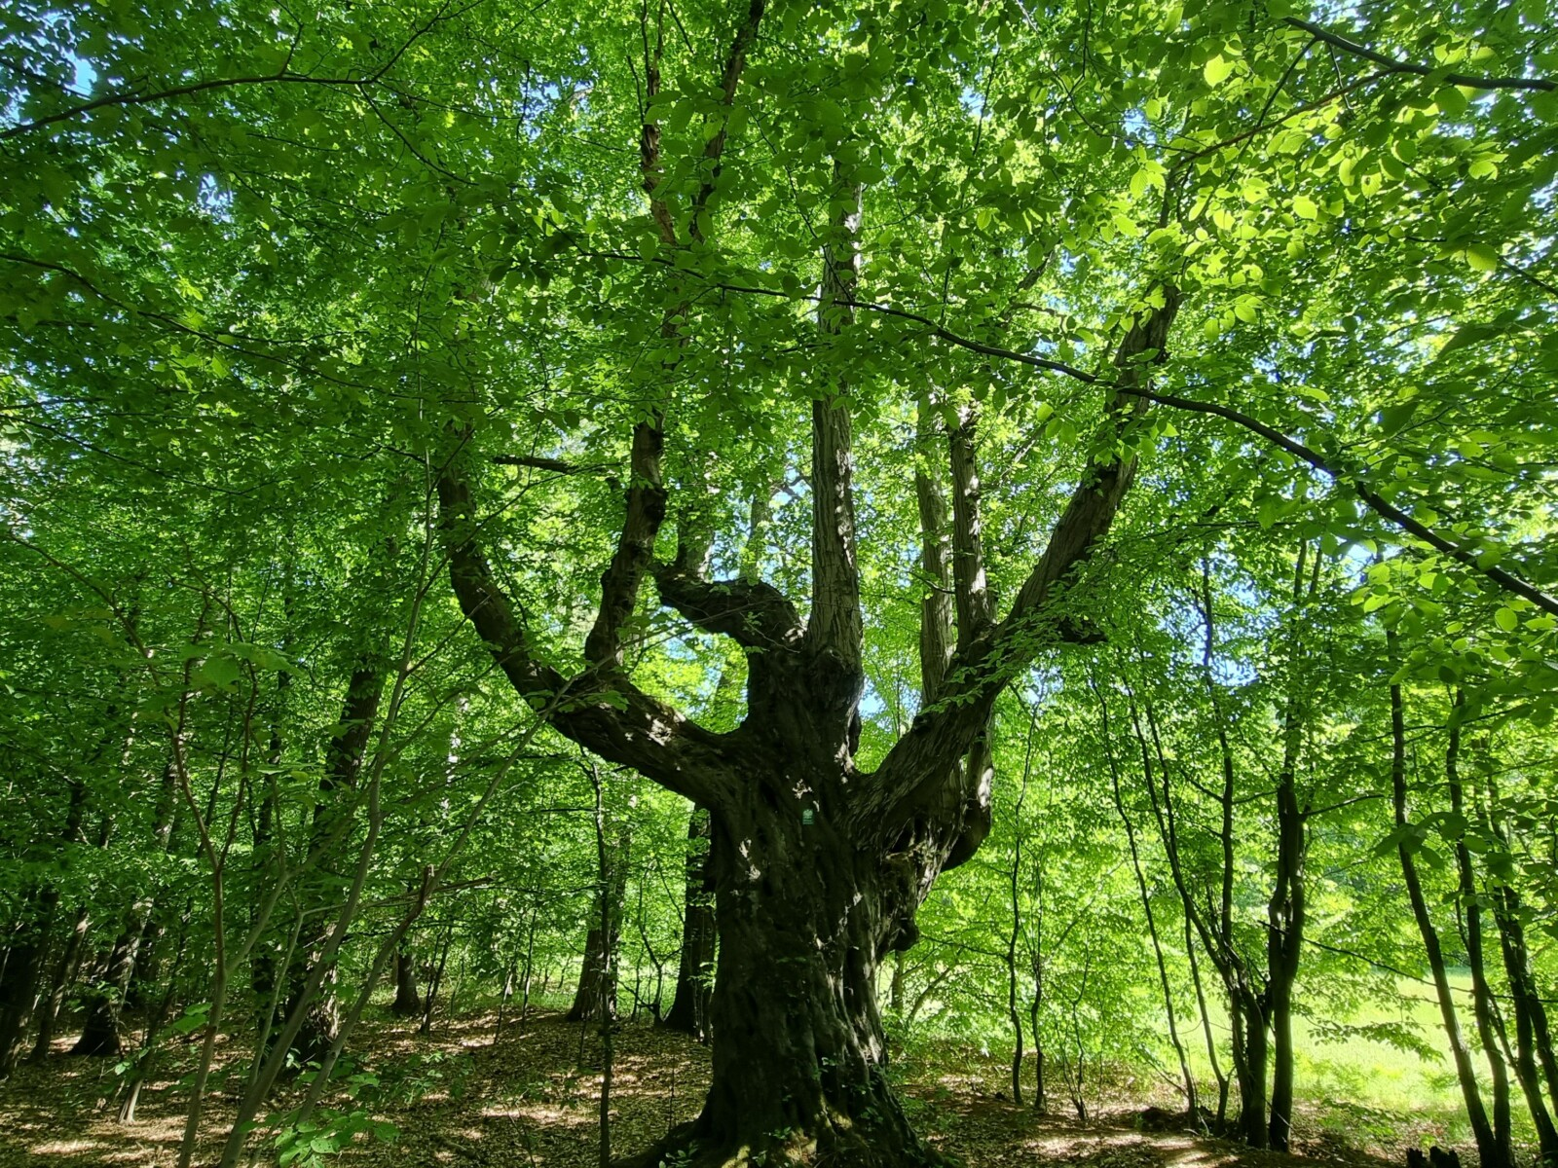
Carpinus betulus – grab pospolity

Slide 3
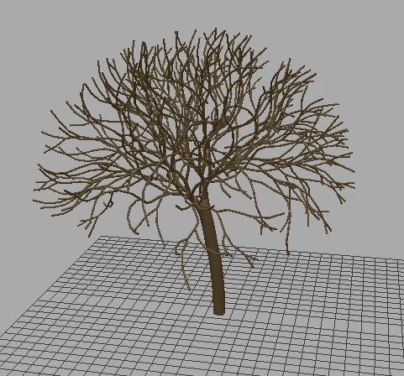
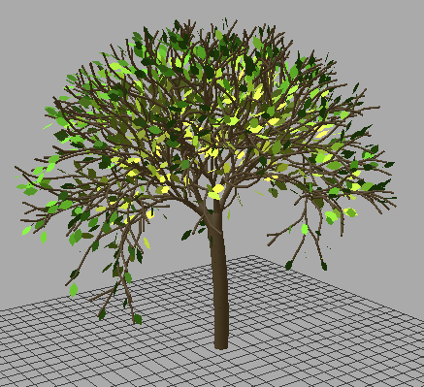
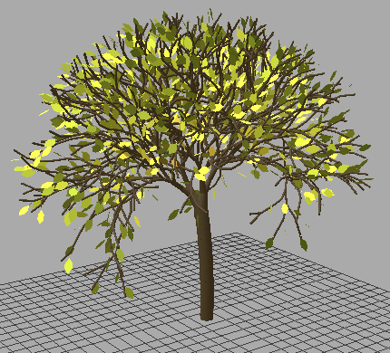
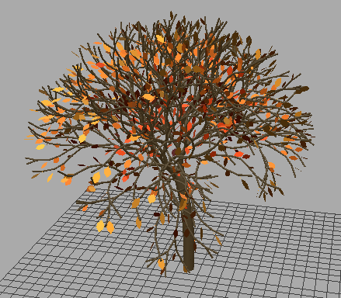
Carpinus betulus in LPy

Slide 4
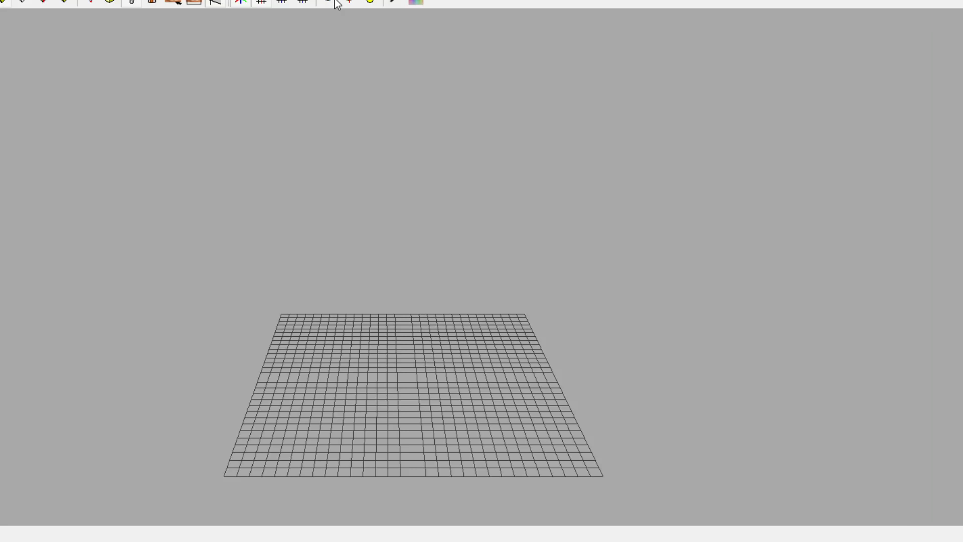
Animation of tree growth and change of leaves

Slide 5
Code for production

Slide 6
production:
# branches production rules
A(k) :
p1 = min(1,(2*k+8)/k**2)
# probability for producing branch with a leaf
r = random.random()
if r <= p1:
produce /(phi)[+(alpha)C(0.1,k)]-(beta)C(step,k)
else:
produce /(phi)[+(alpha)/k(step)]-(beta)C(0.1,k)
# branches module
C(x,k) :
if x >= 1:
if k < 30:
if k < 15:
produce F(1,0.05+0.25/k)A(k+1) # new branches
else:
produce F(1,0.05+0.25/k) # branch is getting narrower
else:
produce C(x,k) # stop growing
else:
produce C(x+step,k)
# leaves module
k(s):
rnd = random.random()
if (rnd < 0.75):
produce k(s+leaf_step) # there is 0.25 chance that leaf won't mature to make some noise in growing
else:
produce k(s)
# trunk module
T(t):
if (t < maximum_trunk_height):
rd = random.random()
if rd < 0.65:
produce SetColor(0) +(0.5)F(0.1) T(t+0.042) # 0.65 chance that trunk will be curved 0.5 degree in positive direction
else:
produce SetColor(0) -(0.5)F(0.1) T(t+0.042) # 0.35 in negative direction
else:
produce T(t) @ stop growing when achievied maximum length

Slide 7
Code for homorphism

Slide 8
homomorphism:
C(x,k):
d = 1
if k > 1:
d = 0.05+0.25* ((x/k)+(1-x)/(k-1))
else:
d = (0.3*(1-x))+((0.05+0.25/k)*x)
if k < 30:
produce F(x, d)
# here leaves change color and size in time
k(s):
if 0 <= s < 114:
produce ;(1)_(0.007)F(0.4)~l((s*1.0)/114) # slow grow
elif 114 <= s <= 118:
produce ;(2)_(0.007)F(0.4)~l(1)
elif 118 <= s <= 124:
produce ;(3)_(0.007)F(0.4)~l(1)
elif 124 <= s <= 135:
produce ;(4)_(0.007)F(0.4)~l(1)
elif 135 <= s <= 150:
produce ;(5)_(0.007)F(0.4)~l(1)
elif 150 <= s <= 170:
produce ;(6)_(0.007)F(0.4)~l(1)
elif 170 <= s <= 190:
produce ;(7)_(0.007)F(0.4)~l(1)
elif 190 <= s <= 210:
produce ;(8)_(0.007)F(0.4)~l(1)
elif 210 <= s <= 230:
produce ;(9)_(0.007)F(0.4)~l(1)
elif 230 <= s <= 250:
produce ;(10)_(0.007)F(0.4)~l(1)
elif 250 <= s <= 270:
produce ;(11)_(0.007)F(0.4)~l(1)
elif 270 <= s <= 290:
produce ;(12)_(0.007)F(0.4)~l(1)
elif 290 <= s <= 320:
produce ;(13)_(0.007)F(0.4)~l(1)
elif 320 < s <= 350:
produce ;(14)_(0.007)F(0.2)~l(0.8) # here they're getting smaller to simulate drying
elif 350 < s <= 380:
produce ;(15)_(0.007)F(0.2)~l(0.8)
elif 380 < s <= 420:
produce ;(15)_(0.007)F(0.2)~l(0.8)
elif 420 < s <= 450:
produce ;(16)_(0.007)F(0.2)~l(0.8)
else:
produce # finally they "fall off"

Slide 9
Statistics for leaves
Change of color and numer of leaves in time

Slide 10
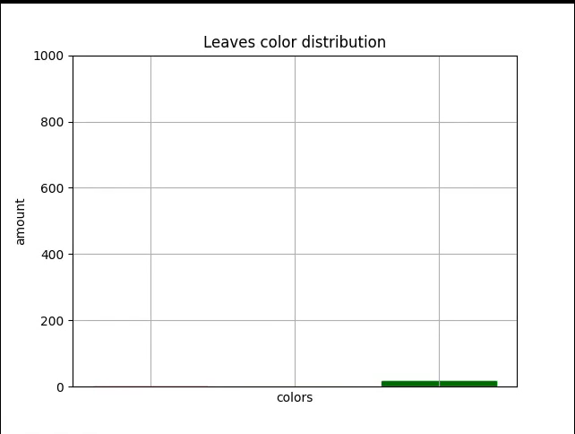

Slide 11
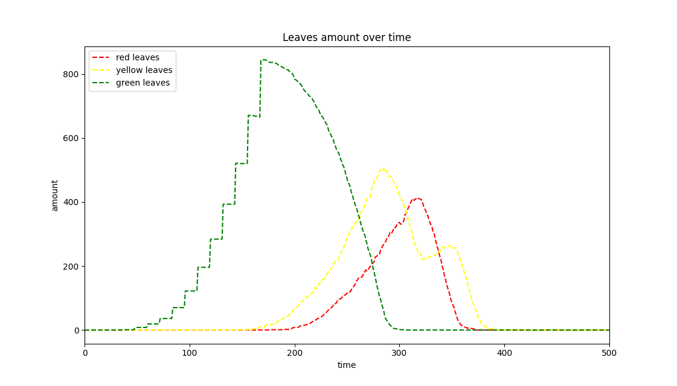

Slide 12

Code in github
https://github.com/Sheaza/l-system-tree

Slide 13
Thank you for your attention
By Natalia Wołowiec
Kacper Kalinowski
Mateusz Miller

